Slide 1
CS F372 Operating Systems
19 – Memory management – Page replacement algorithms

Slide 2
Text Book Reading
Chapter 9
Sections 9.4.1, 9.4.2, 9.4.3 and 9.4.4 till page no. 416

Slide 3
Page Replacement
In demand paging, pages are brought into memory only when needed
If a process has ‘n’ pages, it is not necessary to allocate ‘n’ page frames in the physical memory
Suppose a process with 10 pages uses only half of them, the unused 5 pages need not be brought into the memory
This saves I/O
Degree of multiprogramming can be increased

Slide 4
Page Replacement
Suppose there are 50 frames in the physical memory. There are 10 processes and each has 10 pages
If the entire process is put into the memory, 5 processes can be accommodated
If only 5 frames are allocated for each process, all 10 processes can be accommodated

Slide 5
Page Replacement
If, suddenly, one process tries to use all 10 pages
Page fault occurs for the 5 pages which are to be brought in
While bringing in the pages from the secondary storage device, it is found that there are no free frames in the physical memory- over allocation
We need page replacement
Algorithm that chooses a victim frame in memory swap it out and swap in the required page
algorithm which will result in minimum number of page faults

Slide 6
Page Replacement
While bringing in the pages from the secondary storage device, it is found that there are no free frames in the physical memory
We need page replacement
Algorithm that chooses a victim frame in memory swap it out and swap in the required page
algorithm which will result in minimum number of page faults

Slide 7
Page Replacement
Page fault service routine is modified to include page replacement
Find the location of the desired page on disk
Find a free frame: - If there is a free frame, use it - If there is no free frame, use a page replacement algorithm to select a victim frame
Write the victim page to the disk; change the page and frame tables accordingly for the victim page
Read the desired page into the (new) free frame
Update the page and frame tables for the page being brought in
Restart the process

Slide 8
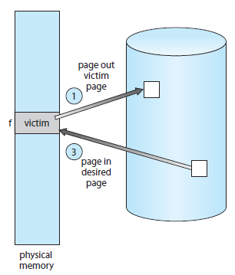
Page Replacement

Slide 9
Page Replacement
If no frame is free, two page transfers are required (one out and one in)
Doubles the page fault service time and increases the effective access time
Use modify (dirty) bit to reduce overhead of page transfers – only modified pages are written to disk.
Modify bit is set when the page is modified since it has been brought into main memory

Slide 10
Page Replacement
Two problems to solve to implement demand paging
Frame-allocation algorithm
Page replacement algorithm
When multiple processes are in memory, should decide how many frames to allocate to each process
When page replacement is needed, which page should be selected for replacement

Slide 11
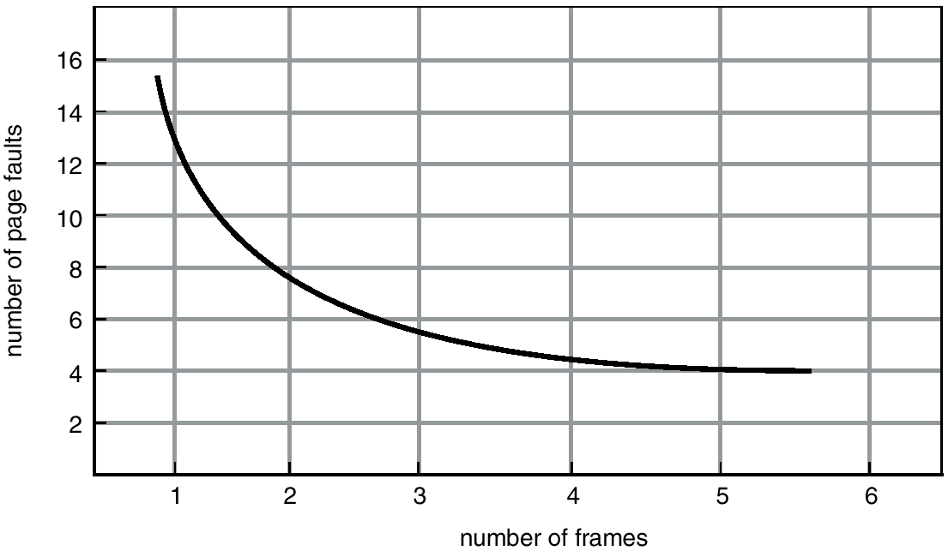
Graph of Page Faults Versus The Number of Frames

Slide 12
First-In-First-Out (FIFO) Algorithm
Simplest page-replacement algorithm
With each page is attached the time when it was brought into memory
When a page must be replaced, the oldest page must be selected
Can be implemented using a FIFO queue to hold all pages in memory
When a page is brought into memory, it is inserted into the tail of the queue

Slide 13
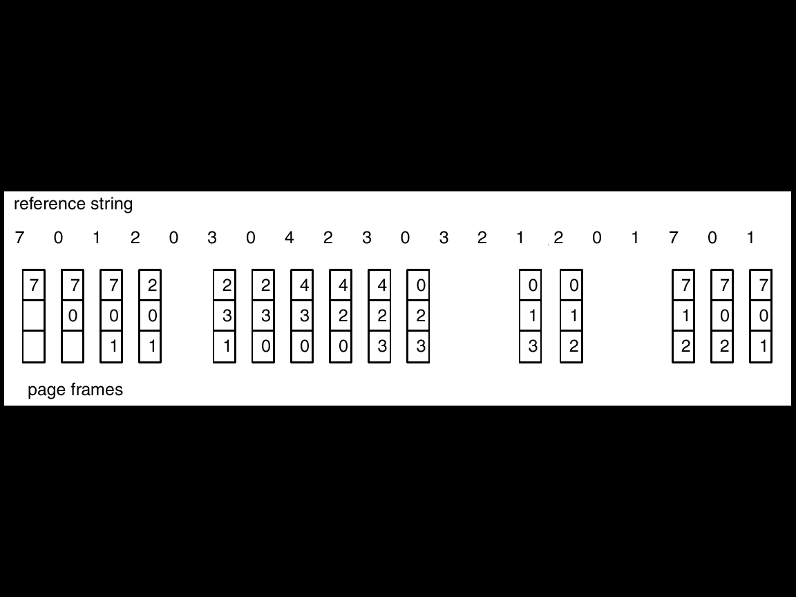
FIFO Page Replacement
15 page faults

Slide 14
First-In-First-Out (FIFO) Algorithm
Performance not good
Initialization module used long ago – not used now
Variable initialized long ago but constantly in use
Even if a constantly used page is moved out, it will only slow down the performance – does not cause incorrect execution

Slide 15
First-In-First-Out (FIFO) Algorithm
Reference string: 1, 2, 3, 4, 1, 2, 5, 1, 2, 3, 4, 5
3 frames (3 pages can be in memory at a time per process)
9 page faults
1
2
3
4
2
3
4
1
3
4
1
2
5
1
2
5
3
2
5
3
4

Slide 16
First-In-First-Out (FIFO) Algorithm
Reference string: 1, 2, 3, 4, 1, 2, 5, 1, 2, 3, 4, 5
4 frames (4 pages can be in memory at a time per process)
10 page faults
Usually more frames ⇒ less page faults
But FIFO Replacement suffers from Belady’s Anomaly
For some page-replacement algorithms, the page-fault rate may increase as the number of allocated frames increases
1
1
2
1
2
3
1
2
3
4
5
2
3
4
5
1
3
4
5
1
2
4
5
1
2
3
4
1
2
3
4
5
2
3

Slide 17
Optimal Algorithm
Replace page that will not be used for longest period of time
Lowest page-fault of all algorithms
Does not suffer from Belady’s anomaly

Slide 18
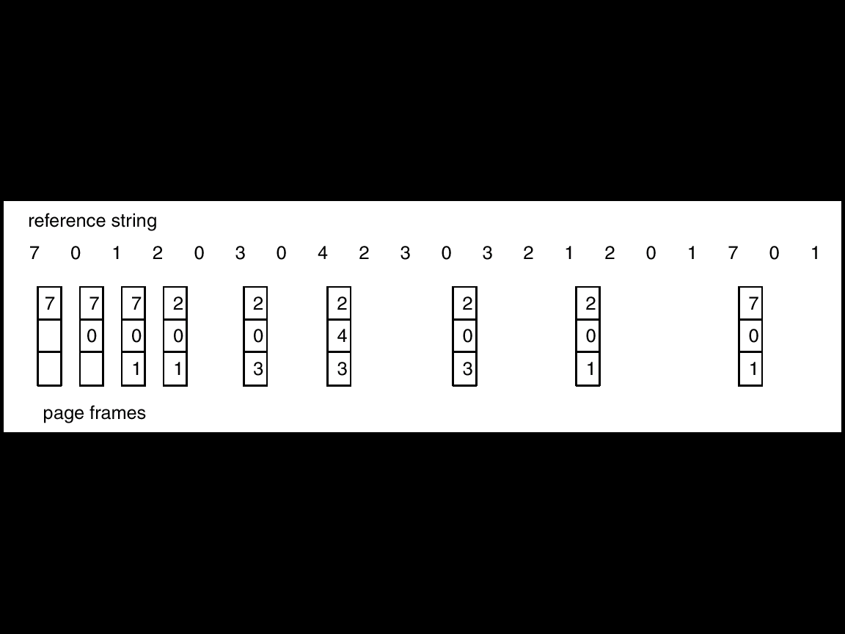
Optimal Page Replacement
9 page faults

Slide 19
Optimal Algorithm
Difficult to implement
Requires future knowledge of the replacement string
Similar to the situation in the SJF CPU scheduling algorithm
Used mainly for comparison studies

Slide 20
Least Recently Used (LRU) Algorithm
Optimal algorithm is not feasible
Approximation to optimal algorithm
FIFO uses the time when a page was brought into memory
OPT uses the time when the page will be used
Recent past is looked at as an approximation of the near future
Replace the page that has not been used for the longest period of time

Slide 21
Least Recently Used (LRU) Algorithm
Associate with each page the time of last use
The page that has not been used for the longest period of time is chosen for replacement
Compared to OPT, this is looking backward in time, rather than looking forward in time
Does not suffer from Belady’s anomaly

Slide 22
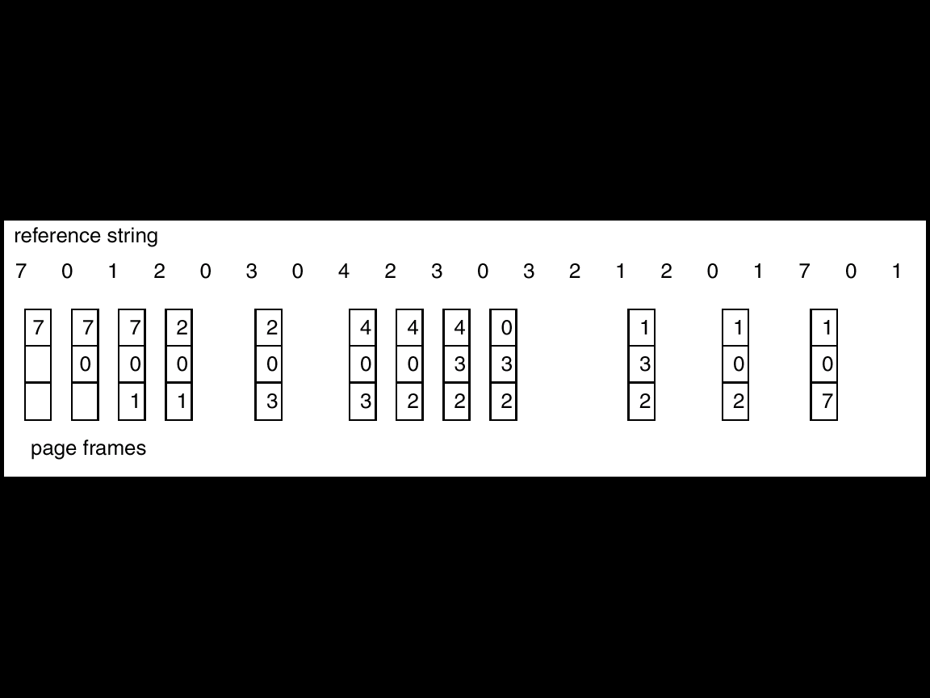
LRU Page Replacement
12 page faults

Slide 23
Least Recently Used (LRU) Algorithm
Good replacement algorithm and is used often
Implementation of LRU
Requires hardware support
To determine the order of use based on the time of last use
Counter implementation
Stack implementation

